Slide 1


Crow Search Algorithm
柔性演算法期末報告
R07546005 沈子暄

Slide 2

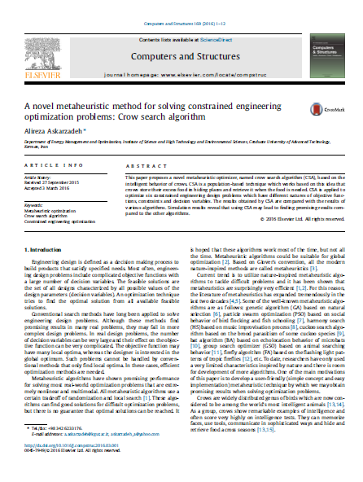
Reference
Article：A novel metaheuristic
method for solving
constrained engineering
optimization problems:
Crow search algorithm
Author：Alireza Askarzadeh
Source：Elsevier

Slide 3
Introduction
在一開始的初始位置即設為初始隱藏點
出門去跟蹤別人或隨機選擇一個點 (awareness probability)
比較現有隱藏點跟新找到的隱藏點，看哪個比較好，記起來
學習烏鴉在集體生活中的覓食行為，將它應用於演算法
→適合解連續性問題

Slide 4
Methods and Problems
Initialize problem and adjustable parameters
Initialize position and memory of crows
Evaluate fitness (objective) function
Generate new position
Check the feasibility of new positions
Evaluate fitness function of new positions
Update memory
Check termination criterion

Slide 5

Methods and Problems
Benchmark:
The effect of AP and fl:
Rosenbrock function
Griewank function
Schwefel function
Ackley function
Rosenbrock function
Griewank function

Slide 6
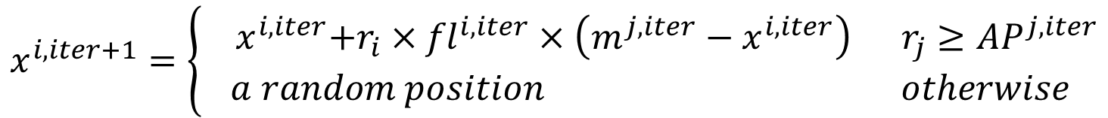
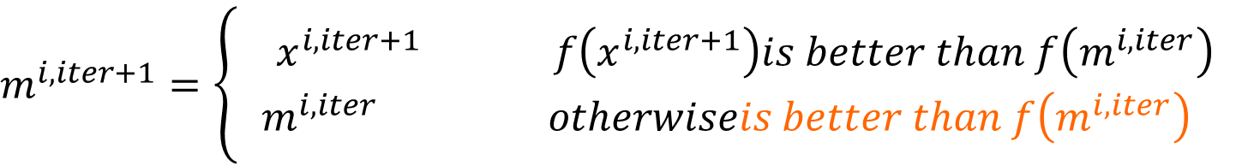
Code
reset()
randomlyinitializesolutions()
runoneiteration()
randomlychooseonecrowtofollow()
updatethebestposition()
$$x^{i,iter+1}=\left\{\begin{aligned}{ x}^{i,iter}+r_{i}×{fl}^{i,iter}×\left(m^{j,iter}−x^{i,iter}\right) r_{j}≥{AP}^{j,iter} \\ a random position otherwise\end{aligned}\right.$$
$$m^{i,iter+1}=\left\{\begin{aligned}{ x}^{i,iter+1} f\left(x^{i,iter+1}\right)is better than f\left(m^{i,iter}\right) \\ m^{i,iter} otherwiseis better than f\left(m^{i,iter}\right)\end{aligned}\right.$$

Slide 7
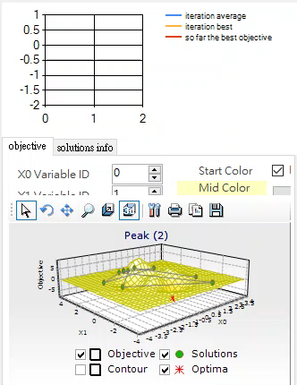
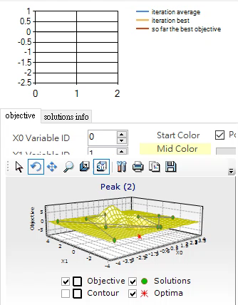
Code
solutions:
mysofarthebestsolution:

Slide 8
Example Tests
Function | Index | GA | PSO | CSA
Rosenbrock function(10) | Best | 617.16 | 120.60 | 26.62
 | Mean | 13161.42 | 10238.65 | 138.94
 | Std | 16926.25 | 12795.70 | 77.34
Griewank function(10) | Best | 1.0019 | 1.0117 | 1.0012
 | Mean | 1.0381 | 1.0648 | 1.0131
 | Std | 0.0689 | 0.1734 | 0.0133
Schwefel function(10) | Best | 924.66 | 1708.68 | 869.59
 | Mean | 1458.77 | 2596.96 | 1626.95
 | Std | 265.93 | 338.41 | 366.49
Ackley function(10) | Best | 4.42 | 4.97 | 1.99
 | Mean | 8.59 | 10.22 | 4.26
 | Std | 2.22 | 2.08 | 1.19
populationsize=20, crossoverrate=0.9, mutatedrate=0.005, AP=0.1, fl=2, iterationlimit=100, run 30 times

Slide 9
Example Tests
Function | Index | AP=0,fl=2 | AP=0.05,fl=2 | AP=0.2,fl=2 | AP=0.3,fl=2
Rosenbrock function(10) | Best | 939.45 | 49.09 | 24.77 | 54.72
 | Mean | 8289.42 | 313.12 | 77.39 | 263.89
 | Std | 5914.29 | 380.14 | 54.89 | 162.86
Griewank function(10) | Best | 1.0018 | 1.0015 | 1.0055 | 1.0056
 | Mean | 1.0118 | 1.0090 | 1.0139 | 1.0161
 | Std | 0.0084 | 0.0065 | 0.0071 | 0.0068
Function | Index | AP=0.05,fl=1.5 | AP=0.05,fl=2.5 | AP=0.2,fl=1.5 | AP=0.2,fl=2.5
Rosenbrock function(10) | Best | 58.21 | 67.30 | 41.94 | 90.99
 | Mean | 342.05 | 218.97 | 152.16 | 350.57
 | Std | 267.06 | 155.56 | 112.51 | 193.33
Griewank function(10) | Best | 1.0048 | 1.0017 | 1.0073 | 1.0028
 | Mean | 1.0212 | 1.0074 | 1.0127 | 1.0181
 | Std | 0.0183 | 0.0037 | 0.0065 | 0.0169
iterationlimit=100, run 10 times

Slide 10
Conclusion and Discussion
iterationlimit = 2000 v.s. iterationlimit = 100 → 數字有差異
整體而言，CSA的演算結果較GA及PSO佳 → 收斂問題
CSA調參結果對演算結果影響很大，應多嘗試求解最適參數
→ 假設驗證：CSA演算結果較PSO及GA佳

